Slide 1

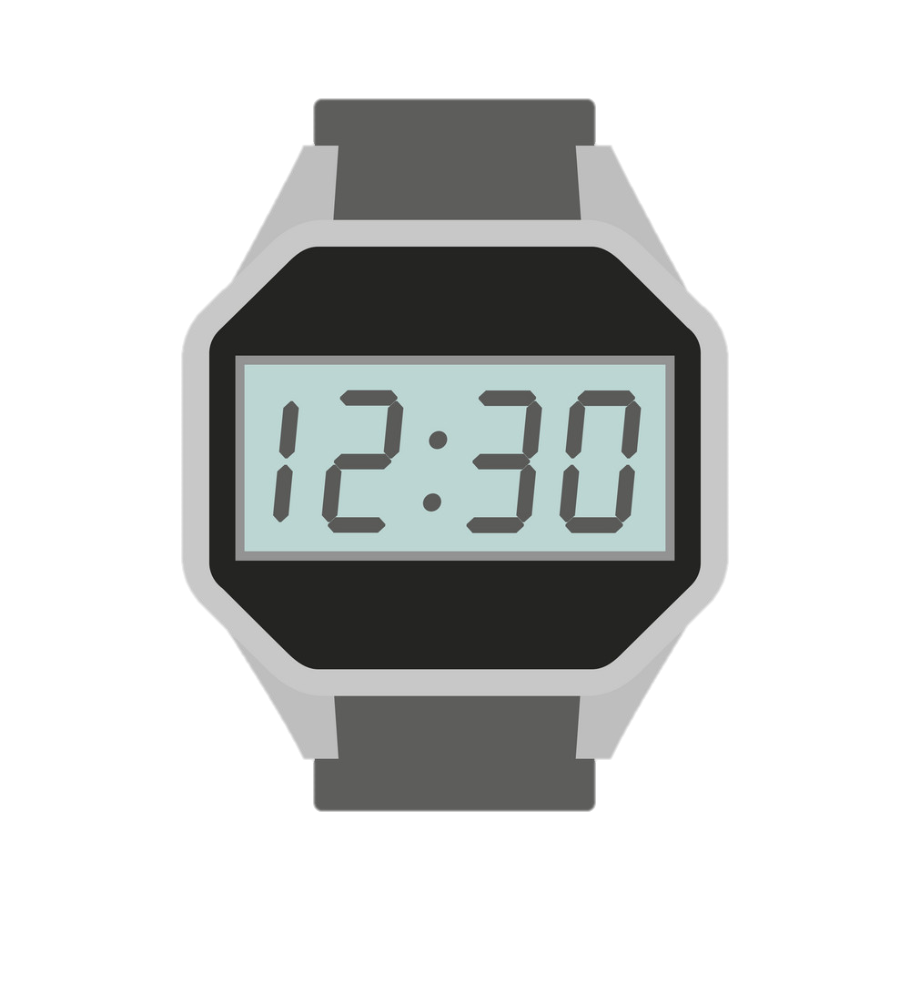
JAVA END SEM PROJECT
19AIE105
TOPIC : DIGITAL WATCH (SOFTWARE BASED)
GROUP 5

Slide 2
CONTENT
ABSTRACT
SOFTWARE USED
SOURCE CODE
OUTPUT
TEAM INFO

Slide 3
ABSTRACT
Our project has been built based on the idea of software based “ DIGITAL WATCH ” which includes the features like DATE, DAY, TIME, STOPWATCH, and ALARM.
It is more like a software based basic digital wrist watch.
Basically, a watch can be used to have a track of our time

Slide 4
Stopwatches can be used to measure the duration of an manually. These are used widely in many aspects. Sports is one the best applications of stopwatch.
Alarm can be used to make ourselves alert or aware about something at some specified time. We are using alarms in our day to day life for many purposes. This makes our works more easier by making us not to remember about that event.

Slide 5


SOFTWARE USED
Visual Studio Code with built-in JDK.
Eclipse IDE.
Referred sources : -
GIT HUB
STACK OVERFLOW
TENSOR FLOW

Slide 6
SOURCE CODE
The source code and project description has been uploaded in GITHUB and link of the repository is given below.
https://github.com/SarrveshNagarajan/SIMPLE-JAVA-WATCH-.git

Slide 7
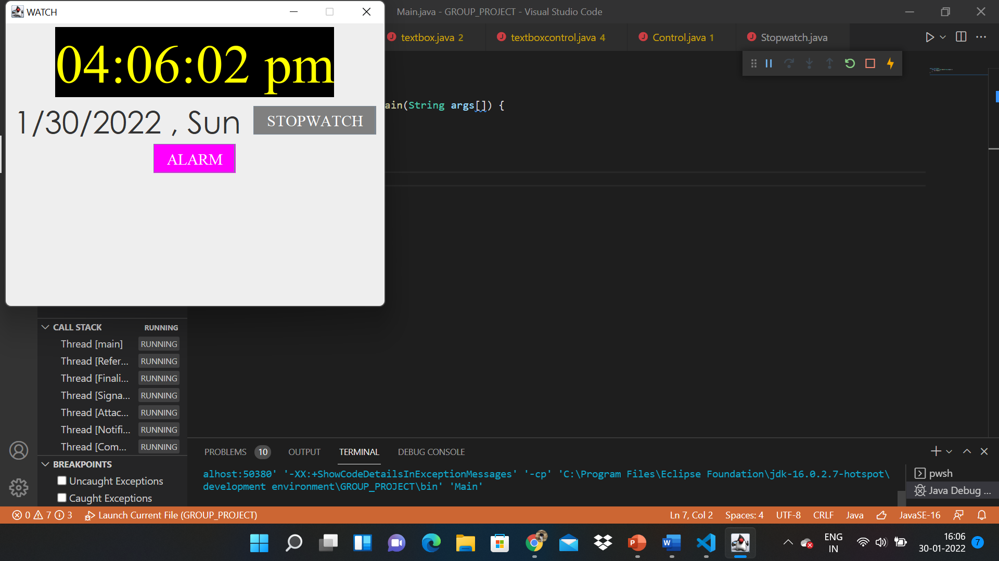
OUTPUT
The screenshots of the output is attached below.

Slide 8
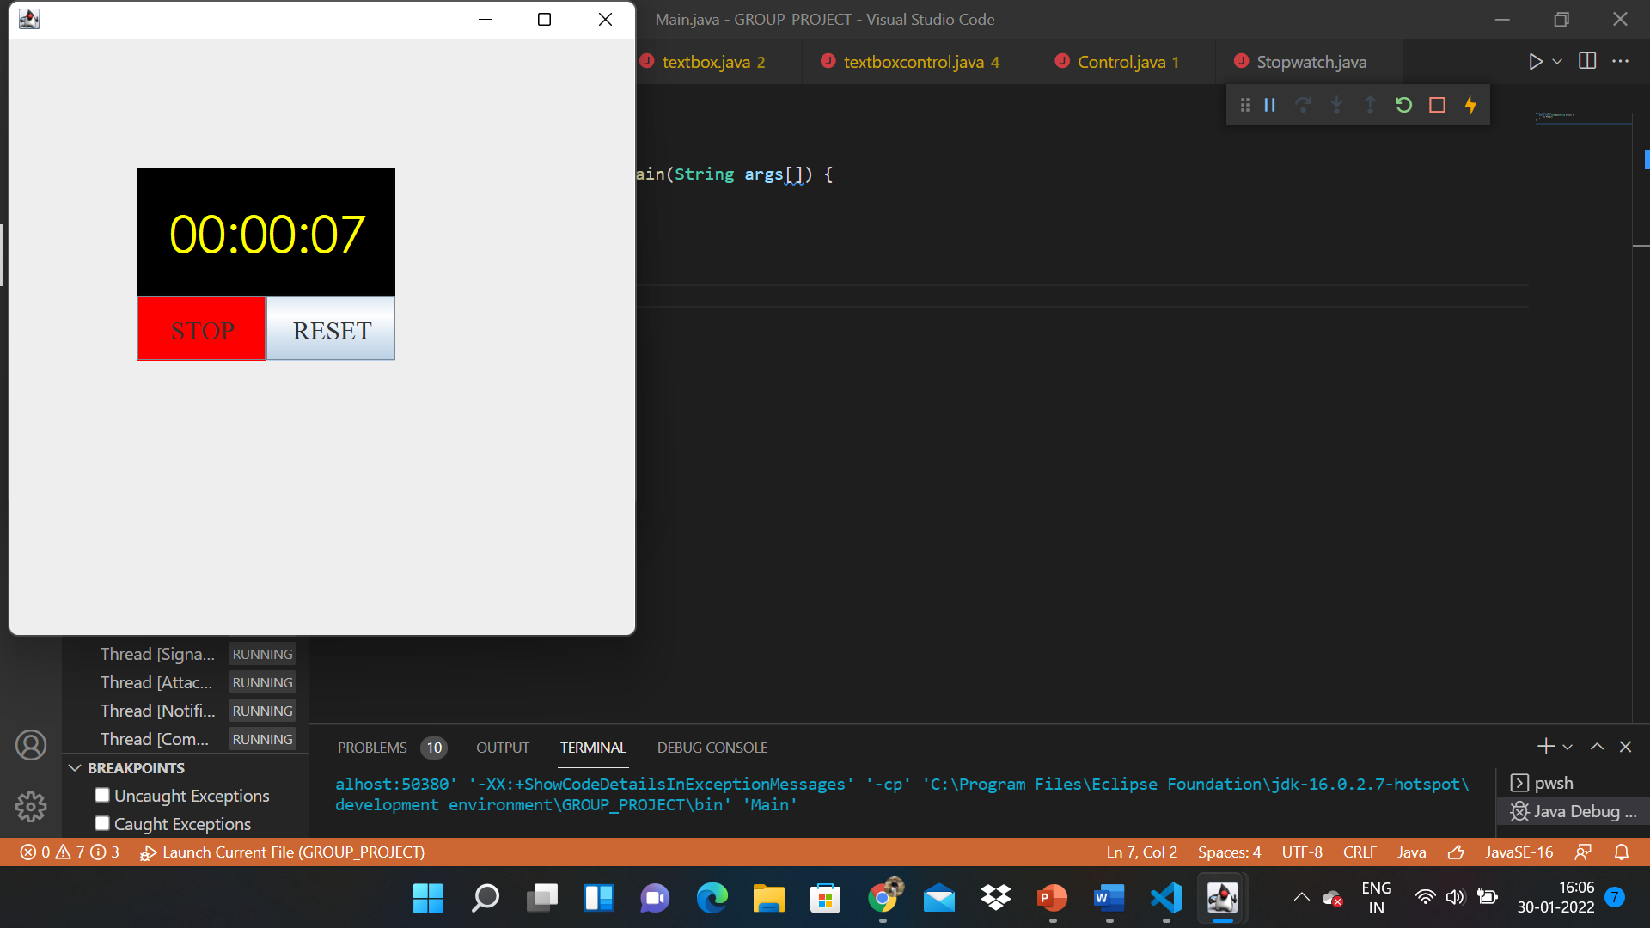

Slide 9
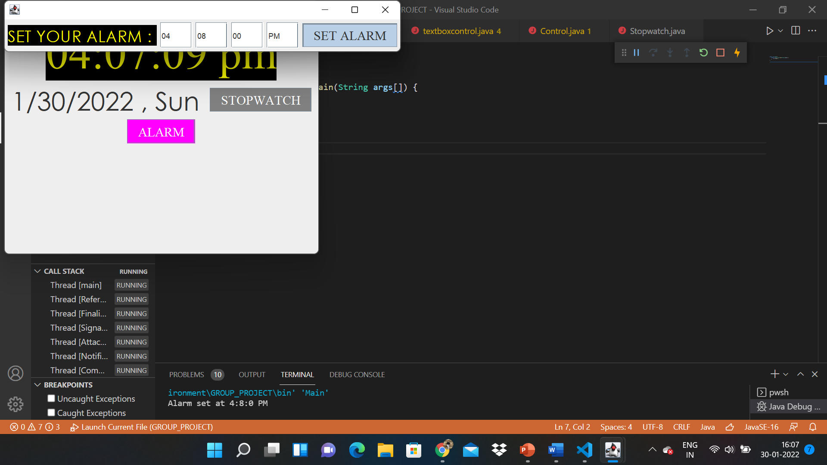

Slide 10
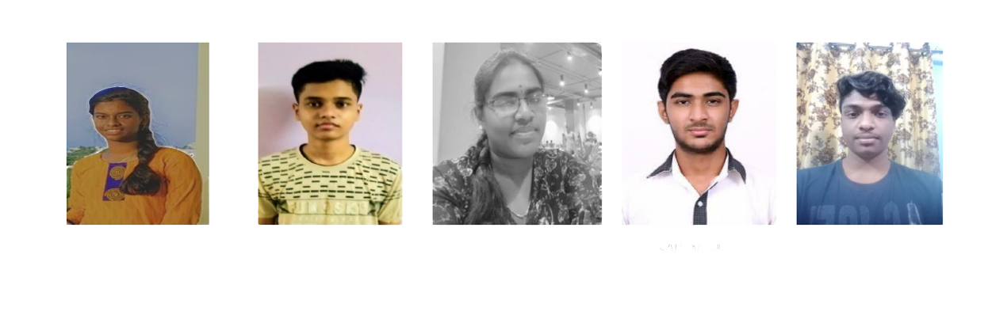
A COLLECTIVE EFFORT OF
POORANI
AYSWARIYA
PRANAV RAJ
YAGNITHA
SARRVESH
SIDESH SUNDAR

Slide 11
THANK YOU !!

